Slide 1

Basic Details of the Team and Problem Statement
Problem Statement Title: DEVELOPMENT & IMPLEMENTATION OF AN INTEGRATED WEB-BASED OFFICE DOCUMENT MANAGEMENT SYSTEM
Theme Name: SMART AUTOMATION
Team Name: DIGITAL CREATOR
Team Leader Name: UTPAL KUMAR
School Code: 65323
School Name: St. Karen’s High School

Slide 2
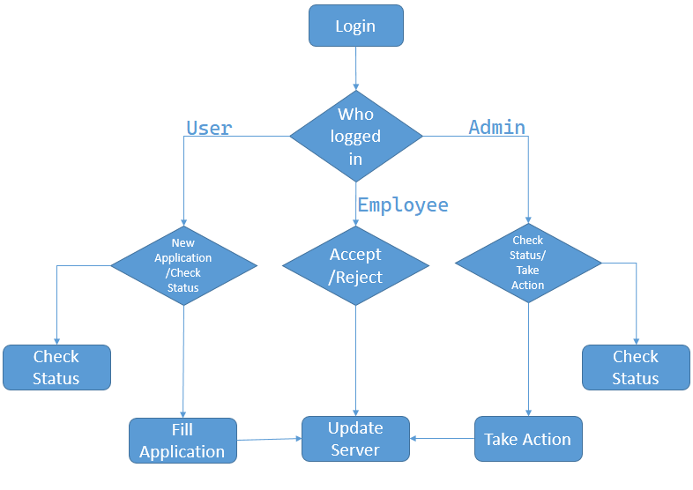
Idea/Approach Details
Describe your idea/Solution/Prototype here:
It contains 3 main phases 1) User or Applicant 2)Application Distributer 3) Working Member or Employee
User have to fill the applicant form and get a user id and password using which they can further check the status of the application.
Application Distributer will have their own user id and password to check the new and awaiting application in their domain. Main work of distributer is to transfer the application and the document to the concerned Department or Ministry.
Staff can further review the application in there own domain and take action accordingly
This will help to reduce the work load on people and even WFH will be encouraged. The use of paper will be decreased and Damaging of files is also reduced to minimum as all the documents will be present on Domains.
Describe your Technology stack here:
MySQL – Database system
PHP – Programming language, well-suited for developing interactive web pages
HTML- For Frontend development.
PYTHON- For OCR

Slide 3
Idea/Approach Details
Describe your Use Cases here
CASE 1:
If user fills the form online then will get an id/pass through which user can review the application or if they fill the paper form then it will be digitalized using ocr.
When the application is sent to concerned department after processing it will be transferred to another department as per required.
The applicant will receive a message of completion
CASE 2:
If the application is sent to concerned department the department will work and if the data is insufficient to process the application will be rejected.
The applicant will receive a message of Failure.
Describe your Dependencies / Show stopper here
HTML5 supporting browsers

Slide 4
Team Member Details
Team Leader Name: Utpal Kumar
Class (6th to 12th ): 12 Stream* (Arts/Science/Commerce etc): Science Age (in number): 18 Gender (M/F): M
Team Member 1 Name: Yasheswani
Class (6th to 12th ): 12 Stream* (Arts/Science/Commerce etc): Science Age (in number): 18 Gender (M/F): F
Team Member 2 Name: Piyush Gaurav
Class (6th to 12th ): 12 Stream* (Arts/Science/Commerce etc): Science Age (in number): 18 Gender (M/F): M
Team Mentor 1 Name: Mr. Tahseen Akhtar
Category (Academic/Industry/Parents): Academic Expertise (AI/ML/Blockchain etc): Core JAVA Domain Experience (in years): 17
Team Mentor 2 Name: Mr. Sanjay Kumar Gupta
Category (Academic/Industry/Parents): Parents Expertise (AI/ML/Blockchain etc): Web Devep Domain Experience (in years): 25
*Stream is only for class 11th and 12th Students. For students below 11th Class, they can write NA.

